Slide 1
Predicting outcomes in crowdfunding campaigns with textual, visual, and linguistic signals
Jermain C. Kaminski & Christian Hopp

Slide 2
Intro.
Over the past years, crowdfunding is increasingly chosen as a gateway to overcome the financial bottleneck for early-stage ventures and new venture development processes.
Despite crowdfunding backers exhibiting expert-like expertise in technological areas, backers are plagued by uncertainty surrounding campaign feasibility and crowdfunders’ technical expertise.
In the following, we, therefore, explore computational techniques to predict crowdfunding campaign success based on the informational cues provided within campaign text, speech, and videos.

Slide 3
Method.
First, we consider combined text, speech, and video information in our analysis.
Second, we employ proven machine learning methods to predict crowdfunding success.
Third, we focus on a homogeneous product category sample and restrict our analysis to technology related products in the Kickstarter categories Technology and Product Design only
Fourth, we marginally improve the prediction accuracy by including information in speech content and video content.

Slide 4
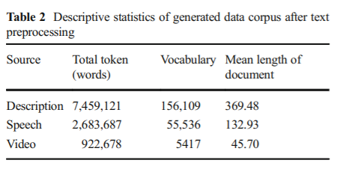
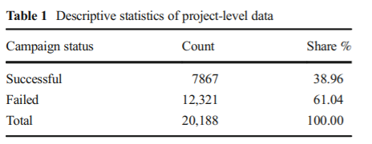
Data.
Scraping 20,188 campaigns (2011 ~ 2017) from Kickstarter.
We restricted our data sample to projects in the categories Technology and Product Design. Additional criteria are that campaigns must include a project description, a project video, non-zero speech content, and were not canceled.
Success : 7876 (38.96%),
fail funding : 12,321 (61.04%)

Slide 5
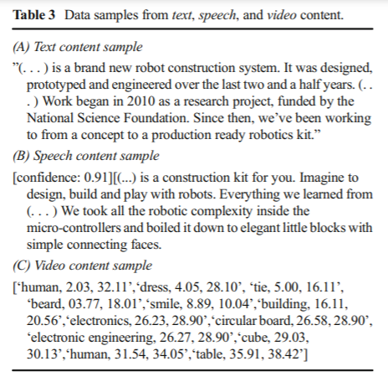
Data
Text : using sikit-learn
- tokenizer and lemmatizer
Speech : Google cloud Speech Rest api, ffmpeg
(신뢰도 0~1, 0.80)
Video : Google cloud Video Intelligence api
-analyze label

Slide 6
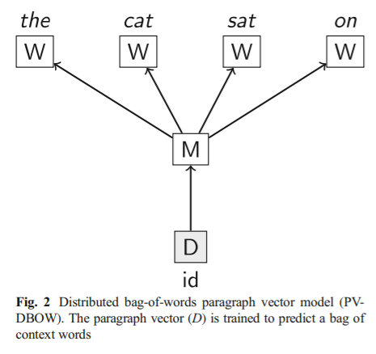
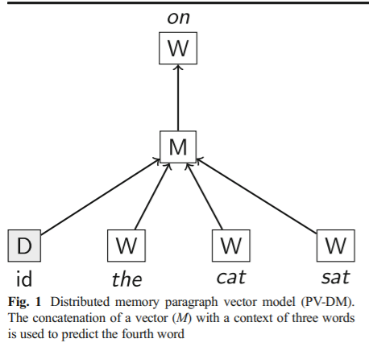
Language Model. - Doc2Vec
PV-DM
PVDBOW

Slide 7
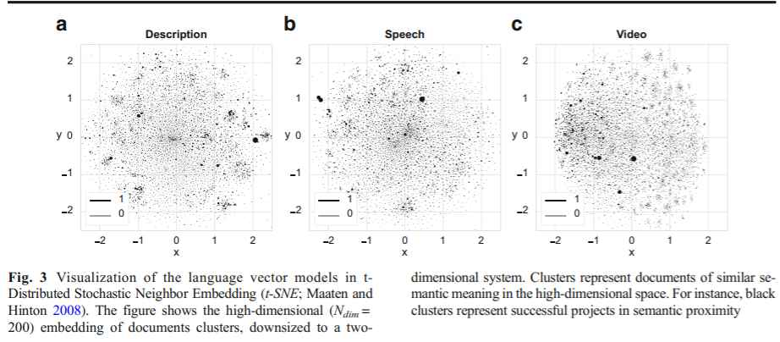
Language vector model

Slide 8
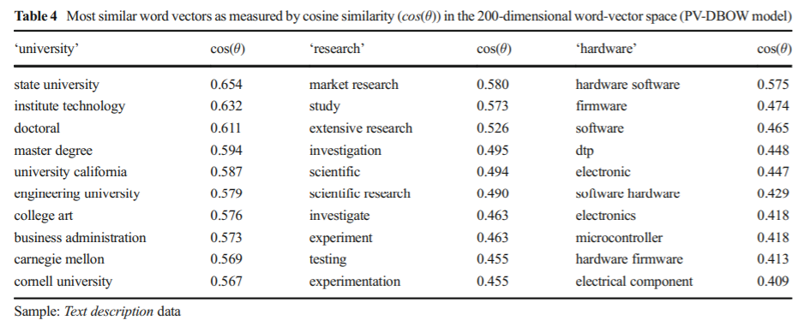
Train result.

Slide 9
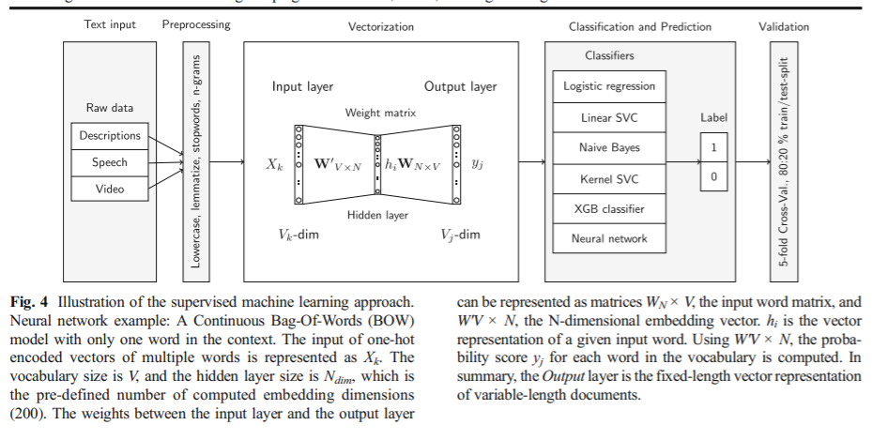
Model illustration.

Slide 10
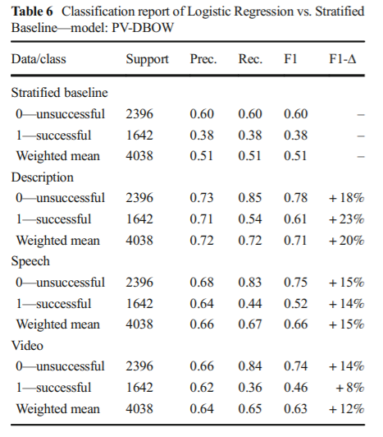
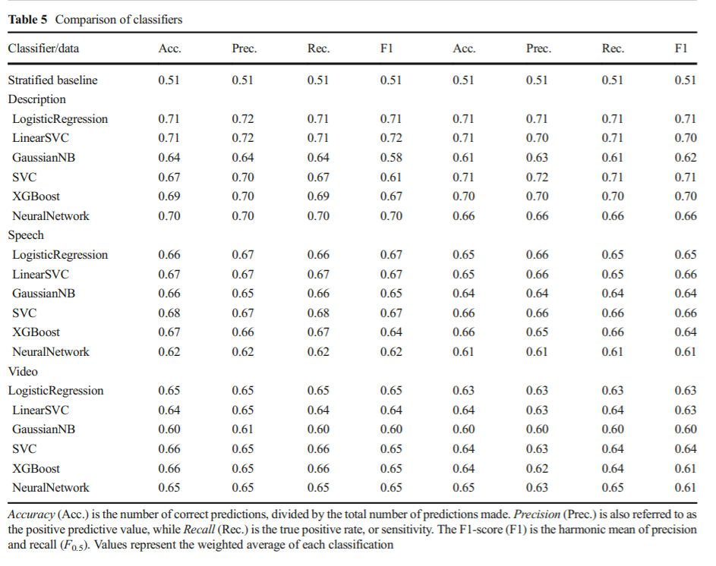
Classifier.

Slide 11
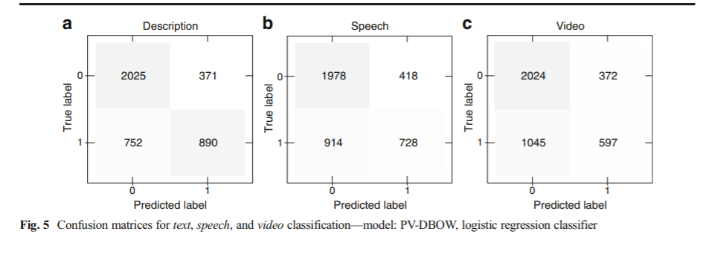
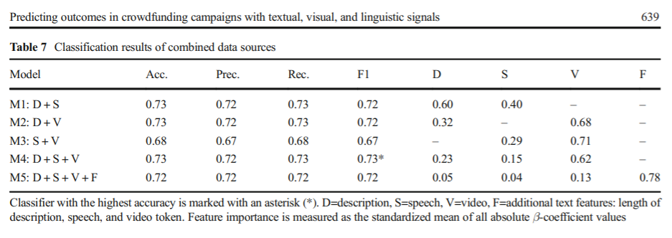
Union.

Slide 12
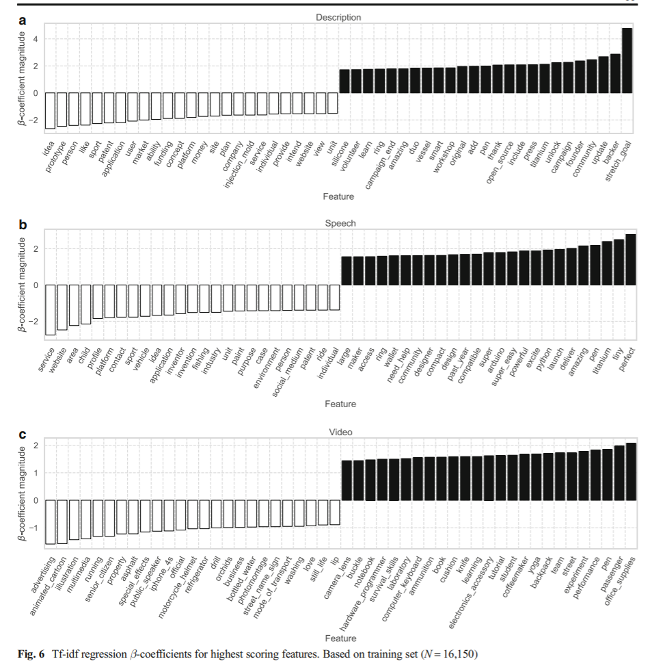
Feature scoring.
Using logistic regression
Black = positive
White = negative

Slide 13
Limitation.
If for any reason, a crowdfunding project raises more than $1 million to create wristwatches for dogs, the algorithm will learn that such a product might be a “good” idea.
As such, the label “successful funding” is very constrained in being a marker of business viability.
Therefore, future explorations should consider to extend the label of “success” toward measurable economic results such as Amazon listings, an active website, or other measures of a product’s market performance after crowdfunding

